Slide 1
File System
By Amit Patel

Slide 2
Introduction
Computers use particular kinds of file systems (sometimes abbreviated FS) to store and organize data on media, such as a hard drive, the CDs, DVDs
A file system can be thought of as an index or database containing the physical location of every piece of data on the hard drive or another storage device. The data is usually organized in folders called directories, which can contain other folders and files.
Files on a storage device are kept in what's called sectors. Sectors marked as unused can be utilized to store data, which is typically done in groups of sectors called blocks.
It's the file system that identifies the size and position of the files as well as which sectors are ready to be used.

Slide 3
Introduction
Definition: A file system is a method for storing and organizing computer files and the data they contain to make it easy to find and access them.
UNIX looks at everything as a file.
UNIX file system also permits creation of folders also called directories.
UNIX also organize its own files into these directories.
A file is a sequence of bits, bytes or lines that is stored on a storage device like a disk.
A UNIX file may contain a source program, an executable code or program for the computer system or database.
Even the printer, RAM, CD ROM drive and terminal are seen as files by the UNIX.

Slide 4
Introduction
UNIX file name may be given using any of the ASCII character except the NULL character and the forward slash.
Any character can be used to construct a file name, it is recommended to use only the following characters.
Alphanumeric Chacracters
The period(.), the hyphen (-) and the underscore(_)
The reason for not using some of the character to construct filenames is that many of the character like &, !, # have special meaning to the shell. This special character is known as metachacter which has special meaning.
UNIX is a case sensitive so NOTES and notes are different.
UNIX file name may or many not have an extension.

Slide 5
File Structure of UNIX
Unix uses a hierarchical file system structure.
It is much like an upside-down tree, with root (/) at the base of the file system and all other directories spreading from there.
Branching from the root there are several other directories called bin, lib, usr, etc, tmp and dev. It is called sub directories. And their parent directory is root directory.
Each of these sub directories contain several files and directories.

Slide 6
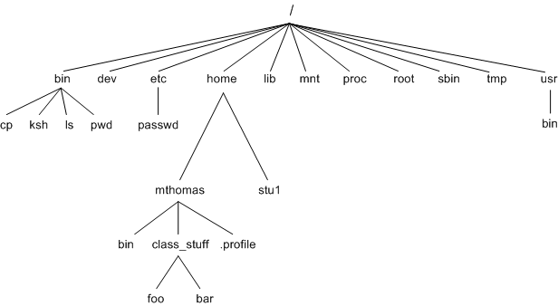
Figure 2.1

Slide 7
Continue…
The main reason behind creation of directories is to keep related files together and separate them from other group of related files.
For example: It is a good idea to keep all user related files in the usr directory.
A UNIX file system is a collection of files and directories that has the following properties:
It has a root directory (/) that contains other files and directories.
Each file or directory is uniquely identified by its name, the directory in which it resides, and a unique identifier, typically called an inode.

Slide 8
Directory | Description
/ | This is the root directory which should contain only the directories needed at the top level of the file structure.
/bin | This is where the executable files are located. They are available to all user. Contains commands that may be used by both the system administrator and by users
/dev | Contain files that control various IO devices like terminal, printer, disk drive etc.
/etc | Binary executable file required for system administrator. Contains configuration files, disk configuration files, valid user lists, groups, Ethernet, hosts, where to send critical messages. This directory contains data similar to those in the Control Panel in Windows
/lib | Contains shared library files and sometimes other kernel-related files.
/home | Contains the home directory for users and other accounts.
/usr | Can be used by many users. Includes administrative commands, shared files, library files, and others. Created by Administrator when he create account for different user. Each user is allowed to work with his directory.

Slide 9
Directory | Description
/tmp | Holds temporary files used between system boots. Temporary space for use by the system, cleaned upon reboot, so don't use this for saving any work!
/kernel | Contains kernel files
/proc | Contains all processes marked as a file by process number or other information that is dynamic to the system.
/mnt | Used to mount other temporary file systems, such as cdrom and floppy for the CD-ROM drive and floppy diskette drive, respectively
/var | Typically contains variable-length files such as log and print files and any other type of file that may contain a variable amount of data
/sbin | Contains binary (executable) files, usually for system administration. For examplefdisk and ifconfig utlities.

Slide 10
Pathname
When the entire file system is organized in the form of hierarchical structure, there should be way to reach the required directories and files.
To reach any specific directory and file a specific route is required
Definition: The route that is taken to reach a file in a file system is known as path to that file.
Depending the beginning point from where a path is defined , there are two types of pathname
Absolute Pathname
Relative Pathname

Slide 11
Figure 2.1

Slide 12
Absolute Pathname
Definition: Pathname that start with slash (/) ,means from root, are called absolute pathname.
From fig 2.1 , the path, one has to take to reach the file “foo” starting from the root is “/home/mthomas/class_stuff/foo”
The path has to take to reach the file “bin” starting from the root is “/usr/bin”

Slide 13
Relative Pathname
Definition: Pathname that start from the present working directory are called relative path names.
For Example: “mthomas” is a present working directory than file “class_stuff” is accessed using the path “mthomas/class_stuff”
A directory in which a user works at a particular point of time is called the current directory or present working directory.
A directory or a file under a present working directory can be accessed by providing the path name that start from the present working directory.
To know the present working directory one has to use the “pwd” command.
The present working directory can be changed using the command “cd”

Slide 14
Absolute Vs Relative Pathname
ABSOLUTE PATHNAME | RELATIVE PATHNAME
Pathname that start with slash (/) ,means from root, are called absolute pathname. | Pathname that start from the present working directory are called relative path names.
Always start with “/”. | Never Start with slash.
To some object ,absolute pathname is same. | To some object, relative pathname is depend on current directory.
Tells how to find a file from the root directory. | Tells how to find a file starting from the current directory.

Slide 15
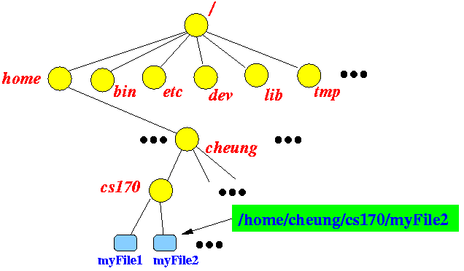

Slide 16
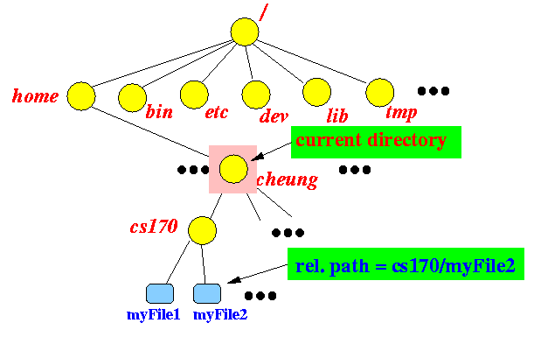

Slide 17
Importance of . And ..
The current directory (.)
In UNIX, (.) means the current directory, so typing
$ cd .
NOTE: there is a space between cd and the dot means stay where you are
But using (.) as the name of the current directory will save a lot of typing.

Slide 18
Importance of . And ..
The parent directory (..)
(..) means the parent of the current directory, so typing
$ cd ..
will take you one directory up the hierarchy (back to your home directory).
NOTE: typing cd with no argument always returns you to your home directory. This is very useful if you are lost in the file system.

Slide 19
Relative and Absolute Pathnames Revisited
(root)
Relative
Absolute
staff
usr
bin
stud
etc
../../../..
/
xxx
gtr
xxx
itmasters
ug
pg
../../..
/stud
Research
Teaching
Private
xxx02u
xxx04u
../..
/stud/ug
CUA
MVR
.profile
CUA
..
/stud/ug/xxx04u
Lecture1.ppt
Coursework1.txt
.
/stud/ug/xxx04u/CUA
Lecture2.doc
You are here!

Slide 20
HOME Directory
The directory into which a user enter automatically when s/he logs in is known as home directory.
It is also known as login directory.
Every user has login directory.
It is created by system administrator whenever he opens an account for a user.
Generally it is created under /usr directory and will have the login name as its name.
“~” defines home directory. So if we write
$ cd ~ change directory to home.
It is found using a shell variable HOME with echo command as shown below.
$ echo $HOME

Slide 21
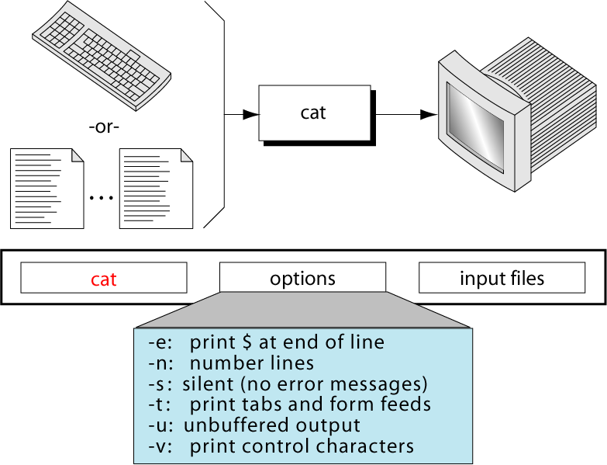
cat Command
Used to
Create a file
Display the contents of one or more a small file on the terminal by appending them the order they are listed in the command.

Slide 22
cat Command
Example : Creating a department file and store content into “dept.lst”
$ cat > dept.lst
01 |Account|121
02 | Admin|131
03 | Finance| 141
Ctrl + d
Here “>” is called “Input Redirection Operator”.
When user enter above command, and press enter, the prompt vanishes. “cat” now wait to take input from the user. Enter the lines and press ctrl+d to signify the end of input.

Slide 23
cat Command
Example 1: Display the content of file dept.lst
$ cat dept.lst
01 |Account|121
02 | Admin |131
03 | Finance| 141
When only one input file is provided, the file is catenated with a null file. The result is that the input file played on the monitor.

Slide 24
cat Command
Example 2: Display the content of multiple file OR catenate two file
$ cat chap01 chap02
The content of second file “chap02” are shown immediately after the first file without any header information. “cat” has done “concatenate the two files” here.
Example 3: What should be the output if we execute only “cat” command?
When you type simply cat command without any arguments, it just receives the stdin content and displays it in the stdout. So after typed the line once, when you press enter, the same line gets printed in the subsequent line as seen above.
$ cat OR cat -
Hello Every one.
Hello Every one.

Slide 25
cat Command
Example 4: Display the content of file with visual characters.
$ cat > chap01
This is a tab between number.
1 |2 |3 |4
$ cat –vet chap01
This is a ^tab^ between number$.
1^I2^I3^I4$
The visual option –v allows us to see control characters, with the exception of the tab, newline, and form feed character.
If we use the option –ve, a dollar sign($) is printed at the end of each tline.
If we use the option –vt, the tab is appear as ^I.

Slide 26
cat Command
Example 5: Display the content of file with line numbers
$ cat –n chap01 chap02
1: This is a tab between number.
2: 1 2 3 4
3:
1: Good Morning
2: Learning Unix commands.
The number line (-n) option, numbers each file as the line is written to the standard output.
If more than one file is being written, the numbering restarts with each file.

Slide 27
IMP. NOTES
COMMAND | EXPLANATION
cat <file name> | Displays the contents of the file.
cat OR cat - | Takes input from STDIN and puts it back to the STDOUT. So after typed the line once, when you press enter, the same line gets printed in the subsequent line.
cat > <filename> | Take input from STDIN and put contents in <filename>, This will overwrite the contents.
cat >> <filename> | Take input from STDIN and put contents in <filename>, This will append the contents.
Try?.... $ cat chap01 -

Slide 28
Exercise
How to concatenate “chap01” file content along with standard input?
How to copy content of “chap01” to “Unit01” using cat command?

Slide 29
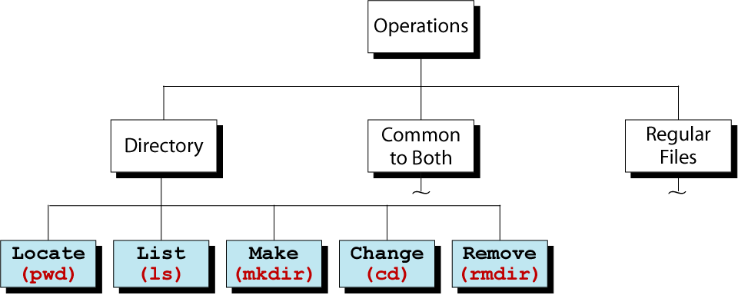
Directory Operations

Slide 30
Pwd (Present Working Directory)
Used to finding the present working directory.
The directory in which a user works at any point of time is known as the current directory.
A Current directory may or may not be the user’s home directory.
$ pwd
/usr/13bca01
NOTE: It always gives the absolute pathname.

Slide 31
cd (Changing Directory)
Used to change your working directory from one to other.
The current working directory may be thought of as the directory you are in, i.e. your current position in the file-system tree.
cd with no argument moves you to your home directory.
For example: Currently we are in surendra directory, which we are see using pwd command, change it to /abc/xyz
$ pwd
/home/surendra
$ cd /abc/xyz
$ pwd
/abc/xyz

Slide 32
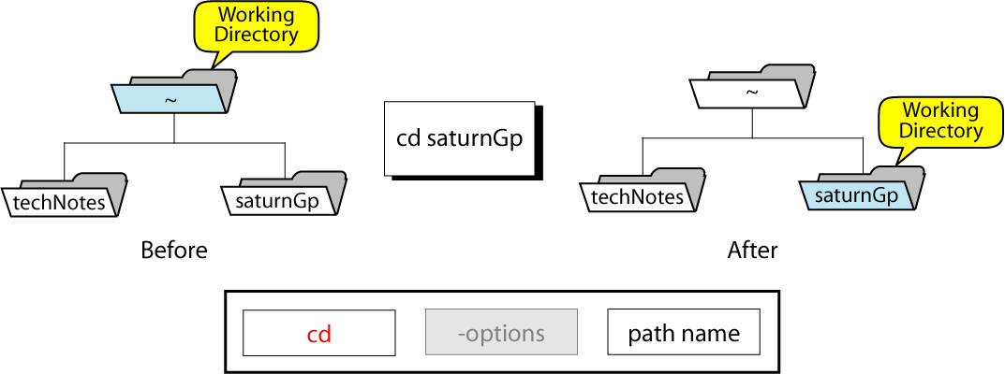

Slide 33
cd (Changing Directory)
Example 2: Change directory from present working directory /var/ftp to /var/ftp/pub using relative path.
$ pwd
/var/ftp
$ cd pub OR $ cd /var/ftp/pub
$ pwd
/var/ftp/pub

Slide 34
cd (Changing Directory)
Example 3: Change working directory to user’s home directory from anywhere in the directory structure.
$ pwd
/etc/samba
$ cd ~
OR
$ cd
$ pwd
/home/surendra

Slide 35
cd (Changing Directory)
Example 4: Change directory to previous working directory which we changed from. And revert to previous working directory we can use same command.
$ cd -
Example 5: Change working directory to parent directory.
$ cd ..
Example 6: Change working directory to present working directory.
$ cd .
Example 7: Change working directory to parents parent directory or two levels up in the directory structure.
$ cd ../..

Slide 36
NOTE
COMMAND | MEANING
$ cd <dir> | Chage Directory to “dir”.
$ cd | Change to Home directory
$ cd ~ | Change to Home directory
$ cd . | Change to Current Directory OR Present Working Directory
$ cd .. | Change to Parent Directory
$ cd - | Change to previous working directory

Slide 37
Importance of . And ..
The current directory (.)
In UNIX, (.) means the current directory, so typing
$ cd .
NOTE: there is a space between cd and the dot means stay where you are
But using (.) as the name of the current directory will save a lot of typing, as we shall see later in the tutorial.

Slide 38
Importance of . And ..
The parent directory (..)
(..) means the parent of the current directory, so typing
$ cd ..
will take you one directory up the hierarchy (back to your home directory).
NOTE: typing cd with no argument always returns you to your home directory. This is very useful if you are lost in the file system.

Slide 39
mkdir Command
Used to create a directories ( Folder ) under the current directory.
The command is followed by the names of the directories to be created.
Example 1: Create a directory patch under current directory.
$ mkdir patch
Example 2: Create a number of sub-directories with one mkdir command.
$ mkdir patch dbs doc # create 3 directory under current directory
Example 3: Create directory chain or tree.
$ mkdir pis pis/progs pis/data
This create 3 sub directories : pis and 2 sub directories under pis.
Order is important in above example because we can create sub directory before directory.

Slide 40
mkdir Command
We can’t enter
$ mkdir pis/data pis/progs pis
NOTE : To create a directory, user must have a write permission otherwise the system refuse to create a directory.
$ mkdir test
mkdir: can’t make directory test.
This can happen due to following reasons:
The directory test may already exist
The user don’t have permission to create directory.
There may be an file by that name in the current directory.

Slide 41
rmdir Command
Used to remove a directories ( Folder ) under the current directory by defualt.
The rmdir cannot delete a directory if it is not empty.
The command is followed by the names of the directories to be deleted.
Example 1: Delete a directory patch under current directory.
$ rmdir patch
Like mkdir, rmdir also used to delete multiple directory in one command.
Example 2: Delete directory chain or tree.
$ rmdir pis/data pis/progs pis
NOTE: When we delete a directory and its sub-directory, reverse logic is applied.
We can’t enter, its give error
$ rmdir pis pir/progs pis/data

Slide 42
rmdir Command
Following rules must be remember when deleting directories.
Cant delete directory unless it is empty. In this case , we cant delete pis directory because it is not empty. It contain two directory- data and progs.
Can’t delete a sub-directory unless we are placed in a directory which is hierarchically above the one you are chosen to remove.

Slide 43
ls Command
Used to list all files in the current directory.
Following options are available with this command.
Option | Description
-x | Display output in multiple columns.
-F | Mark Executable with * and directories with /
-a | Show all file including hidden files
-r | Sorts file in reverse order ( ASCII collating sequence )
-R | Recursive listing of all files in current directory.
-t | Sort files by modification time.
-l | Long listing showing seven attributes of a file.
-u | Sort files by access time.
-i | Show inode number of file.
-S | Sort file by file size.

Slide 44
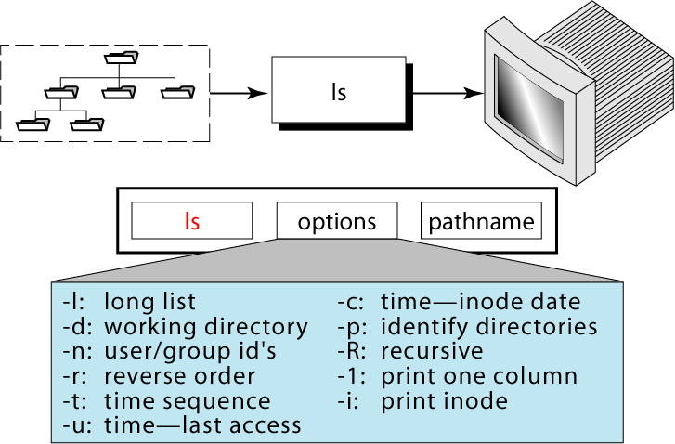

Slide 45
ls Command
For Example visit following website
http://www.tecmint.com/15-basic-ls-command-examples-in-linux/
http://www.thegeekstuff.com/2009/07/linux-ls-command-examples/

Slide 46
ls Command
Example 1: List Files using ls with no option
ls with no option list files and directories in bare format where we won’t be able to view details like file types, size, modified date and time, permission and links etc.
$ ls
0001.pcap Desktop Downloads index.html install.log.syslog Pictures Templates
anaconda-ks.cfg Documents fbcmd_update.php install.log Music Public Videos

Slide 47
ls Command
Long listing (-l)
Example 2:List Files With option –l
Here, ls -l (-l is character not one) shows file or directory, size, modified date and time, file or folder name and owner of file and it’s permission.
$ ls -l
total 5
-rw-r--r--. 1 root root 683 Aug 19 09:59 0001.pcap
-rw-------. 1 root root 1586 Jul 31 02:17 anaconda-ks.cfg
drwxr-xr-x. 2 root root 4096 Jul 31 02:48 Desktop
drwxr-xr-x. 2 root root 4096 Jul 31 02:48 Documents
drwxr-xr-x. 4 root root 4096 Aug 16 02:55 Downloads

Slide 48
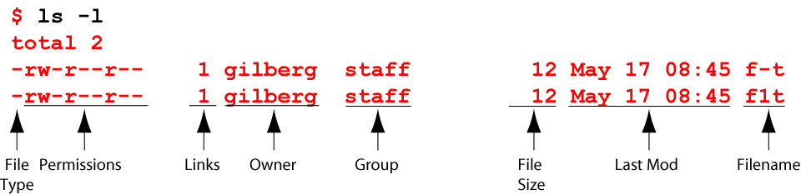
Long List Option
File types: - Regular file
d Directory
Three sets of permissions: owner, group, and other.
Each set has three permissions: r, w, and x

Slide 49
ls Command
Show hidden file (-a)
Example 3: View Hidden Files
List all files including hidden file starting with ‘.‘.
$ ls -a
. .bashrc Documents .gconfd install.log .nautilus .pulse-cookie
.. .cache Downloads .gnome2 install.log.syslog .netstat.swp .recently-used.xbel

Slide 50
ls Command
Identifying Directories and Executables (-F)
Example 4: List Files and Directories with ‘/’ Character at the end
Using -F option with ls command, will add the ‘/’ Character at the end of each directory.
$ ls -F
0001.pcap Desktop/ Downloads/ Calender* index.html install.log.syslog Pictures/ Templates/ anaconda-ks.cfg Documents/ fbcmd_update.php install.exe* Music/ Public/ Videos/ TOC.sh*

Slide 51
ls Command
Reversing order (-r)
Example 5: List Files in Reverse Order
The following command with ls -r option display files and directories in reverse order.
$ ls -r
Videos Public Music install.log fbcmd_update.php Documents anaconda- ks.cfg Templates Pictures install.log.syslog index.html Downloads Desktop 0001.pcap

Slide 52
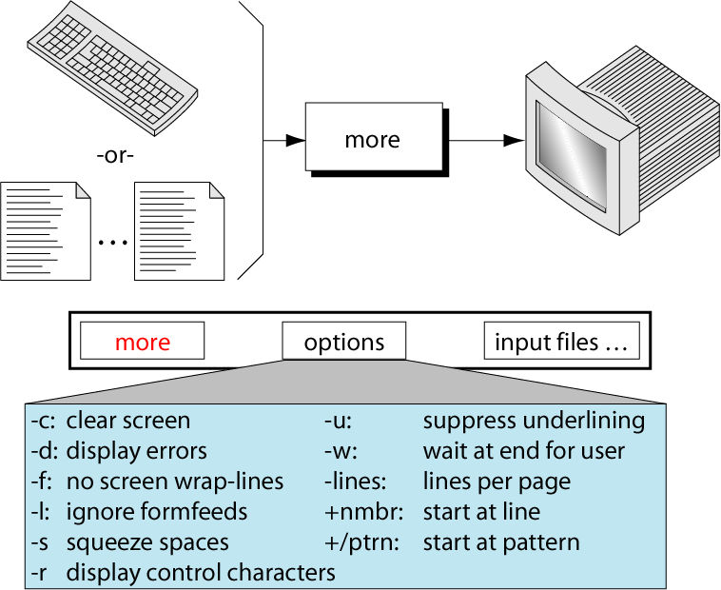
The more Command
Use more command to display a file.

Slide 53
more Continue Operations
space Displays next screen of output
return Advances one line
d Displays half a screen
Q, q Quits more
= Displays current line number
:f Displays the current filename and line number
v Transfers to vi editor at the current line
. Repeats the previous command

Slide 54
more Vs cat
Cat displays file contents. If the file is large the contents scroll off the screen before we view it. There is no automatic pause at the end of screen.
command 'more' is like a pager which displays the contents page by page.

Slide 55
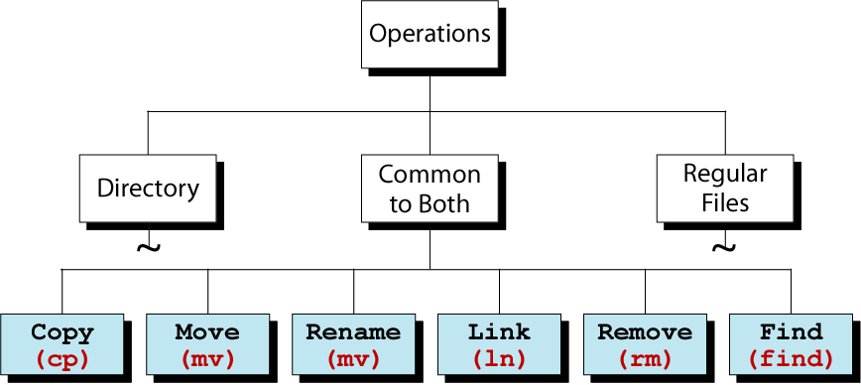
Operations Common to Directories and Files

Slide 56
cp Command
cp means COPY.
Used to copies files or a group of files.
Create a exact image of the file on the disk with a different name.
Syntax require at least two filenames to be specified in the command line.
$ cp chap01 unit01
NOTE: If destination file (unit01) is not exist, it will first be created before copying take place. If it exist, it will overwritten without any warning from the system.
OPTION | DESCRIPTION
-i | Interactive copying means ask if destination file is exist for overwritten or not.
-r | Use to Copying entire directory structure

Slide 57
cp Command
Example 1: Copy file chap01 into directory progs with name unit01
$ cp chap01 progs/unit01
Example 2: Copy file chap01 into directory progs.
$ cp chap01 progs
Here chap01 file is copy into directory progs with same name.
Example 3: Copy chap01 from /usr/13bca01 to current directory using short hand notation.
$ cp /user/13bca01/chap01 .
Here ( . ) represent current directory to chap01 file is copy from /user/13bca01/ to current working directory.

Slide 58
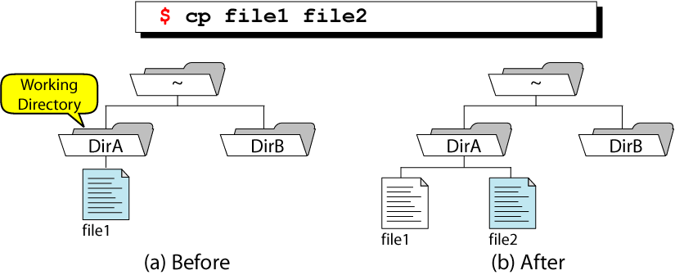
Simple File Copy

Slide 59
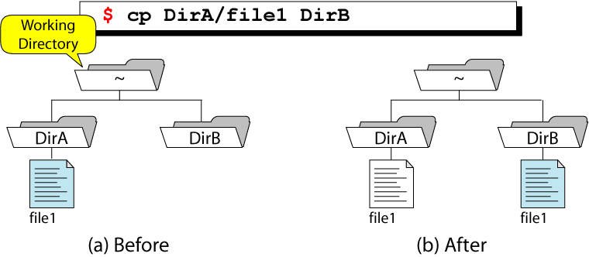
Copy File to A Directory From Home

Slide 60
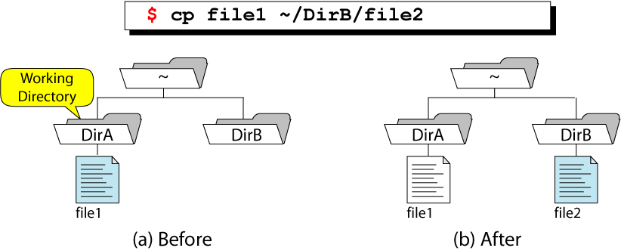
Copy and Rename File

Slide 61
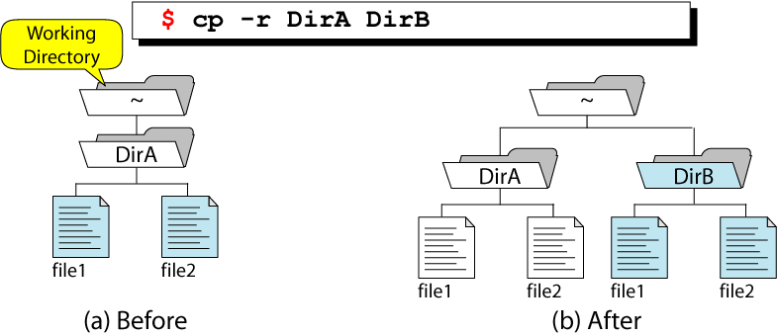
Recursive Copy

Slide 62
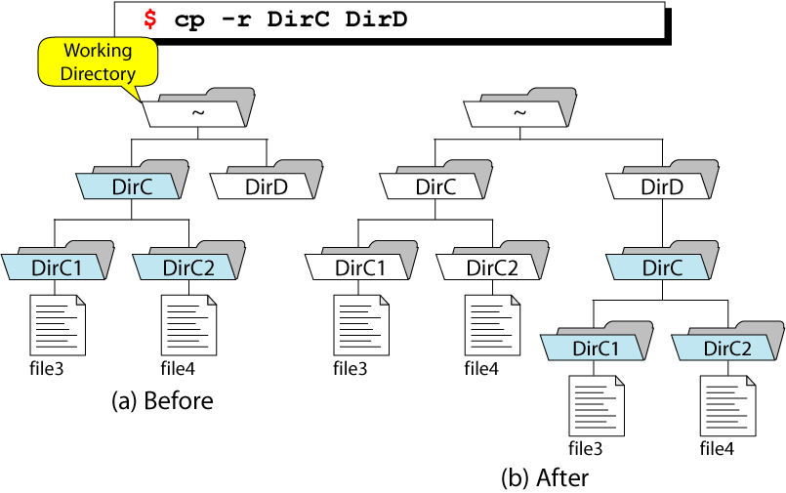
Recursive Copy with Subdirectories

Slide 63
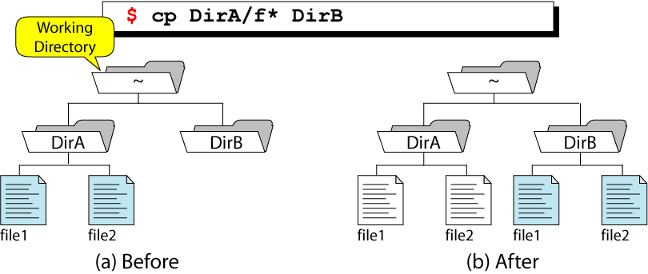
Wildcard Copies

Slide 64
cp Command
Example 4: Copy multiple file chap01,chap02,chap03 into progs directory
$ cp chap01 chap02 chap02 progs
NOTE: This command run if progs directory exist because cp won’t create it. These files retains their name.
This command also written in following ways
$ cp chap* progs
Here we use wildcard character * which copy all files which start with “chap”

Slide 65
cp Command
Example 5: Copy file using interactive copying option.
$ cp –i chap01 unit01
cp: overwrite unit01? y
If we say “y” at this prompt, it overwrite the file.
Example 6: copy directory progs into newprogs
$ cp -r progs newprogs
Here we use –r option, its copy entire directory progs with its sub-directory to newprogs.
NOTE: Sometime copy fail, because we try to copy file which is read protected or the destination file or directory is write protected.

Slide 66
mv Command
mv command is a command that similar with cp, but it does not create a copy / duplicate of files or directories.
Used to
Renaming the files and directories.
Move either an individual file, a list of files, or a directory.
Mv command has interactive (-i) option available.

Slide 67
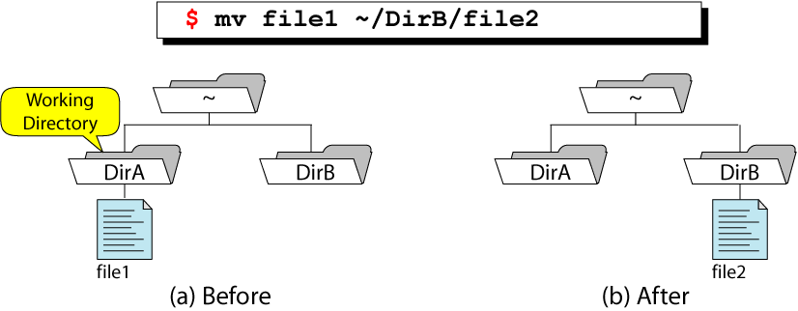
Move File

Slide 68
mv Command
Example 1: Moving files
The requirement of moving file is the file source location must be different with the files destination location. Here’s an example.
To move file_1.txt from current directory to another directory , for example /home/pungki/office, here’s the syntax :
$ mv chap01.txt /home/BCA/office
Example 2: Moving multiple files
$ mv chap01.txt chap02.txt chap03.txt /home/BCA/office

Slide 69
mv Command
Example 3: Renaming files or directory
To rename the files or directory, destination location must be the same with the source location. Then the file name must be different.
Let say we are inside /home/BCA/Documents folder and we want to rename chap01.txt into file_1.txt. Then the command will be like :
$ mv chap01.txt file_2.txt
If we mention the absolute path, then it will look like this :
$ mv /home/BCA/Documents/chap01.txt /home/BCA/Documents/file_2.txt

Slide 70
mv Command
NOTE
The new-File file must not exist; otherwise, 2 things can happen:
If the new-File exists and it is the name of a file, then the mv will report an error (and will not rename the file)
If the new-File exists and it is the name of a directory, then the mv will move the file old-File into the directory new-File-Path

Slide 71
rm Command
rm means REMOVE.
Used to remove files or a group of files.
It normally operate silently and should be used with caution.
If it used without option, normally it delete all files
OPTION | DESCRIPTION
-i | Interactive Deletion means ask file should be deleted or not.
-r | Recursive Deletion Use to remove entire directory structure.
-f | Forcefully remove files and directories even if it is write protected.

Slide 72
rm Command
Example 1: Delete file chap01 and chap02 from progs directory.
$ rm progs/chap01 progs/chap02
Example 2: Delete all files in current directory.
$ rm *
Here * means all files.
NOTE: Beware to use this , because it cant prompt any message like “Are you sure, you want to delete all files.

Slide 73
rm Command
Example 3: Delete file using interactive copying option.
$ rm –i chap01 chap02
chap01: ? Y
chap02: ?y
If we say “y” at this prompt, it overwrite the file.
Example 4: Remove entire directory with all files and subdirectories
$ rm -r progs
rm normally not remove directories but when used with –r (recursive) option it do it.

Slide 74
State Why –r option is dangerous with rm?
When we used –r (Recursive Deletion) option with “rm” command it perform tree walk – perform recursive search for all sub-directories and files within these sub-directories.
For Example : $ rm –r *
Delete all files and sub-directories in current directory.
If you don’t have backup, then these files will be lost forever.
If “rm” command used with –r and –f option it forcefully deleted all files if it is write protected.
For Example: $ rm –fr *
Delete all files and sub-directories even if it is write protected.

Slide 75
wc Command
wc means WORD COUNT.
Used to count lines, words and character depending on the option used.
It take one or more filenames and display 4 column output.
If it used without option, normally it delete all files which is written with rm command as arguments.
OPTION | DESCRIPTION
-l | Count line in file.
-w | Count word in file.
-c | Count character in file.

Slide 76
wc Command
Example 1: Create a file and count number of line, word and character in this file.
$ cat infile
I am the wc command
I count characters, words and lines.
With options I can also make selective count.
$ wc infile
3 20 103 infile
Count 3 line , 20 words and 120 character in infile.

Slide 77
wc Command
Example 2: Count line in file “infile”.
$ wc –l infile
3 infile
Example 3: Count word in file “infile”.
$ wc –l infile
20 infile
Example 4: Count character in file “infile”.
$ wc –l infile
103 infile

Slide 78
Importance of /etc/passwd file
The /etc/passwd file is used to keep track of every registered user that has access to a system.
The /etc/passwd file is a colon-separated file that contains the following information:
User name
Encrypted password
User ID number (UID)
User's group ID number (GID)
Full name of the user (GECOS)
User home directory
Login shell

